Slide 1
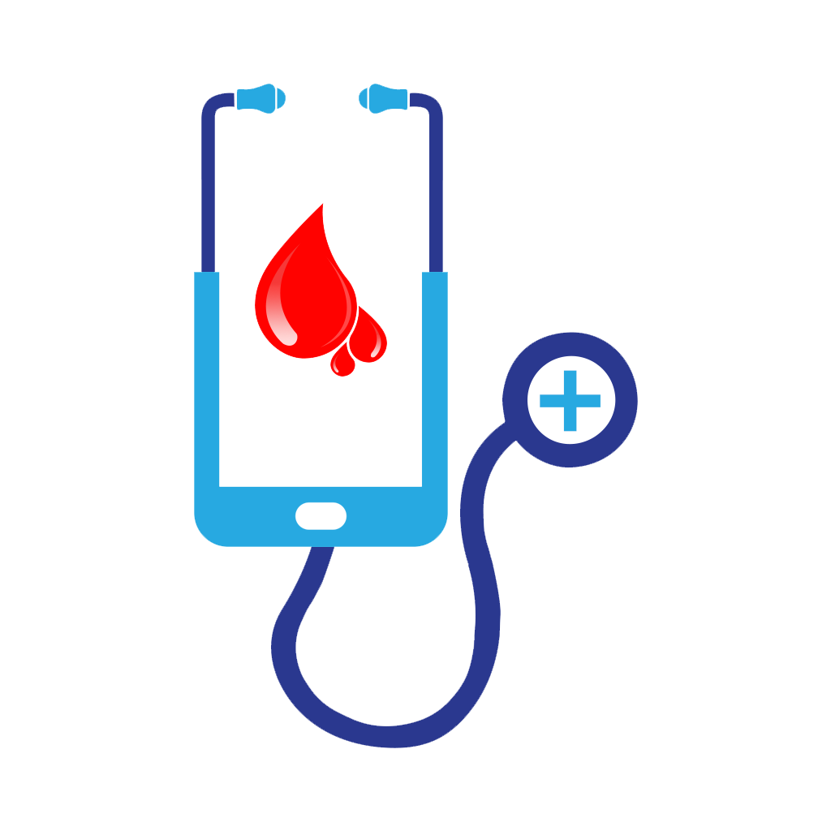
A MID DEFENSE ON ‘E-BLOOD BANK’
PRESENTED BY:
DIPESH DEUJA
KAREENA BADE
SANAM SUWAL
SUJATA SHRESTHA

Slide 2
CONTENTS
Introduction
Objective
Scope
Literature review
Methodology [context diagram, use-case diagram, tools and platform]
Work done
Work to be done

Slide 3
INTRODUCTION
Background
Idea behind the title
An Android application that allows the users to search and notify donors of specific blood group based on their location, in a short period of time.
Not only display the list of donors but also facilitated with tracking the location of the nearby donors through global positioning system
Notify the donors via the alert buzzer in mobile app or the sms in case of emergencies

Slide 4
OBJECTIVE
To bridge the communication/information gap between blood banks, hospitals, donors and needy people using android user interface and GPS tracking service

Slide 5
SCOPE
Real-time availability of donor as per blood group.
Willing person can donate where needed which fulfils any shortage in blood bank.
Blood donation campaign or any other related social awareness information can notify to all the registered users with ease.
This system will build maintain a proper communication between donor and recipients including blood banks, hospitals and health centres.

Slide 6
LITERATURE REVIEW
S.N. | RESEARCH PAPERS | REVIEWS
1. | Blood Bank Connect Android Application | Blood Bank Automation using Android application in which blood inventory will be managed and automated on line, User can quickly check for blood banks or hospitals in the emergency situation you can find the matching of particular or related blood group and reach to the particular location through the App
2. | Blood Donor Tracker By using GPS | Included login page where in the user is required to register and only then can view the availability of blood and may also register to donate blood, helps to select the right donor online instantly using medical details along with the blood group
3. | Tracking System for Blood Donor Using GPS | Locates the nearest blood donor in cases of emergencies in fastest & easiest way using GPS, Data analysis was done based on the questionnaire received from few users
4. | Blood Bank Application Using Cloud Computing | Android application which allows the user to search donors of specific blood group based on their location, in a short period of time, facilitated with tracking the location of the nearby donors and providing SMS alerts, GPS module is included to locate the donors
5. | Online Blood Bank Management System Using Android Application | Included price variations along with stock handlings, increase in blood types which may lead to increase in human blood infrastructure and categories to be managed
6. | Location Based Online Blood Bank System | Global Positioning System and nearest neighbour algorithm used for primary blood transfusion services, SMS and email services

Slide 7
METHODOLOGY

Slide 8
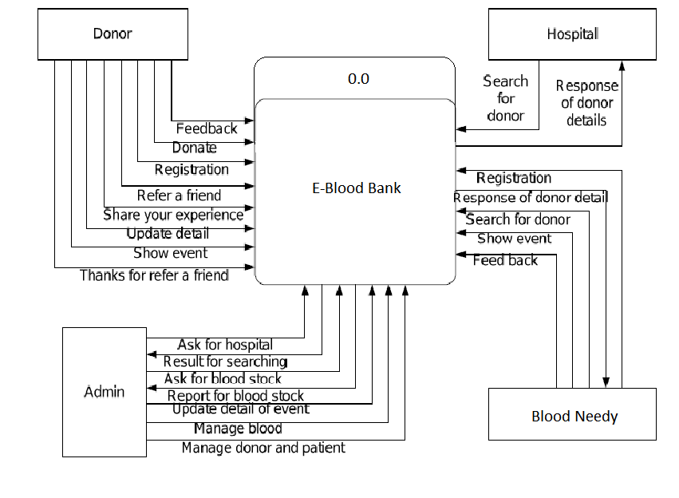
Context diagram

Slide 9
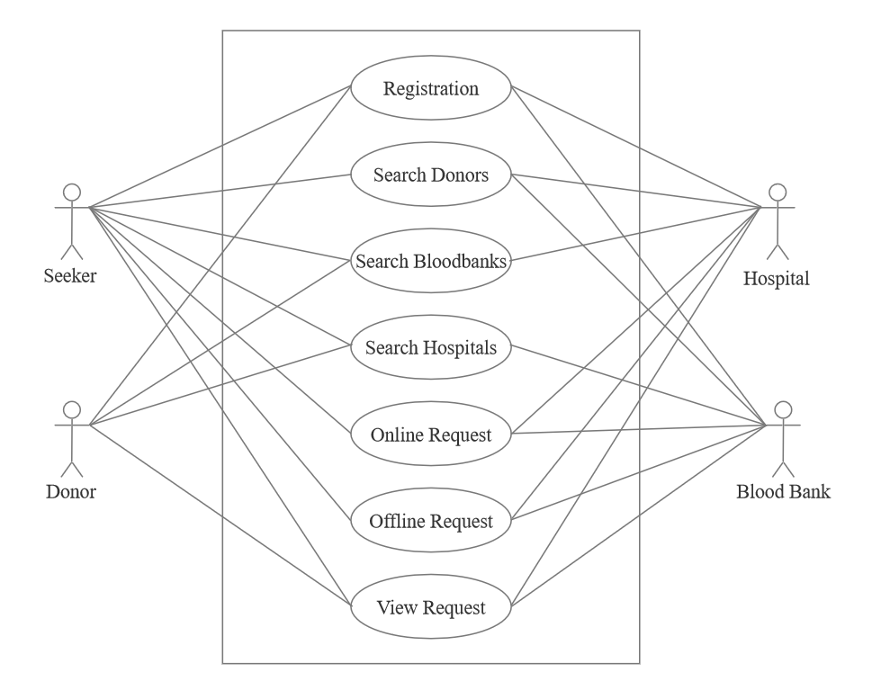
Use-case diagram

Slide 10
Tools & platform
VS Code IDE
Flutter
Android Studio
Windows
Android device
SQLite 3
Flask
Python

Slide 11
Dijkstra Algorithm
11
What and Why?
Solution the single-source shortest path problem in graph theory
Works on all graph with non negative weights
Approach: Greedy
Input: path cost to all nodes
Output: Shortest path cost from single source to all the nodes

Slide 12
Dijkstra Algorithm
12
Main Basic Formula:
If [{ d(u) + Cost( u , v ) } < d(v) ]:
d(v) = d(u) + Cost( u, v)

Slide 13
Our approach
13
We use single device as a node
α
Number of devices
Complexity of algorithm application
Get Euclidian distance range keeping source at center
Limit Donors to 10
Find path to each node using directions
Find shortest path cost to each nodes using algorithm
Compare and Refer shortest available path

Slide 14
∞
∞
14
2
B
D
10
8
0
A
7
9
1
4
3
C
2
E
∞
∞

Slide 15
WORK DONE
15

Slide 16
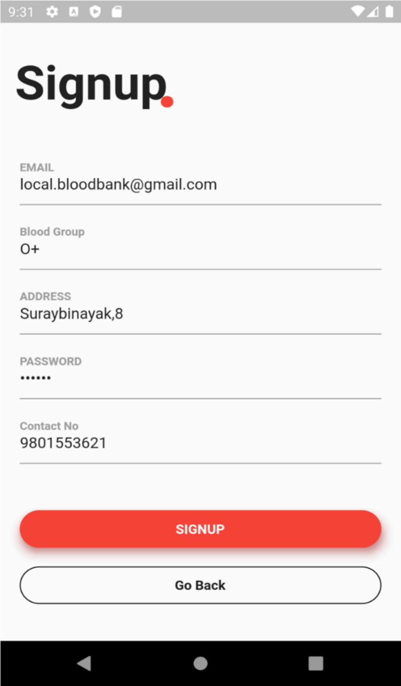
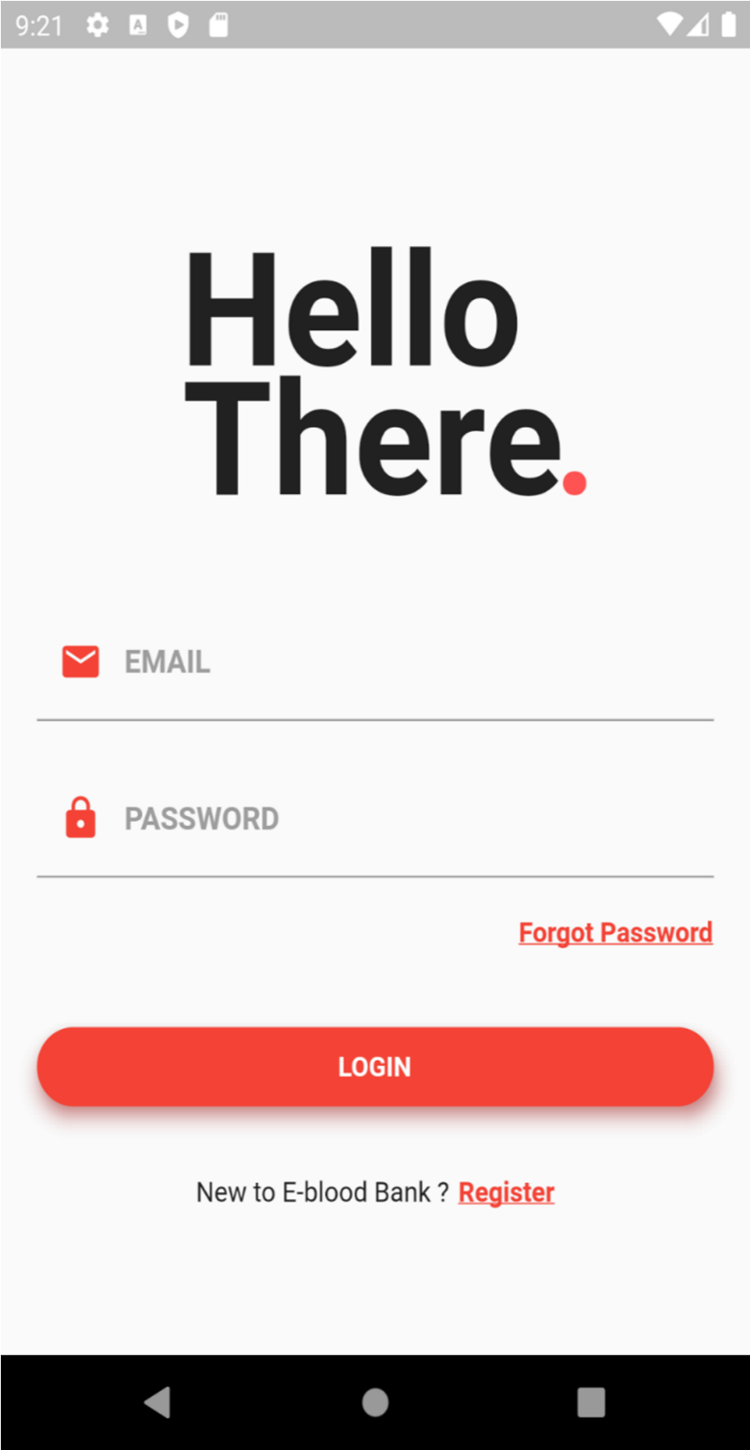
Fig 1:Flutter App Sign Up
Fig 2:Flutter App Login

Slide 17
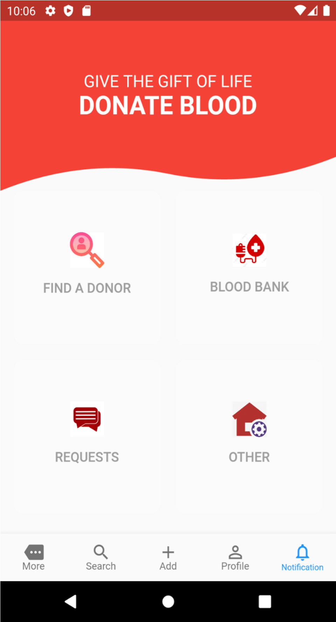
Fig 3:User Dashboard

Slide 18
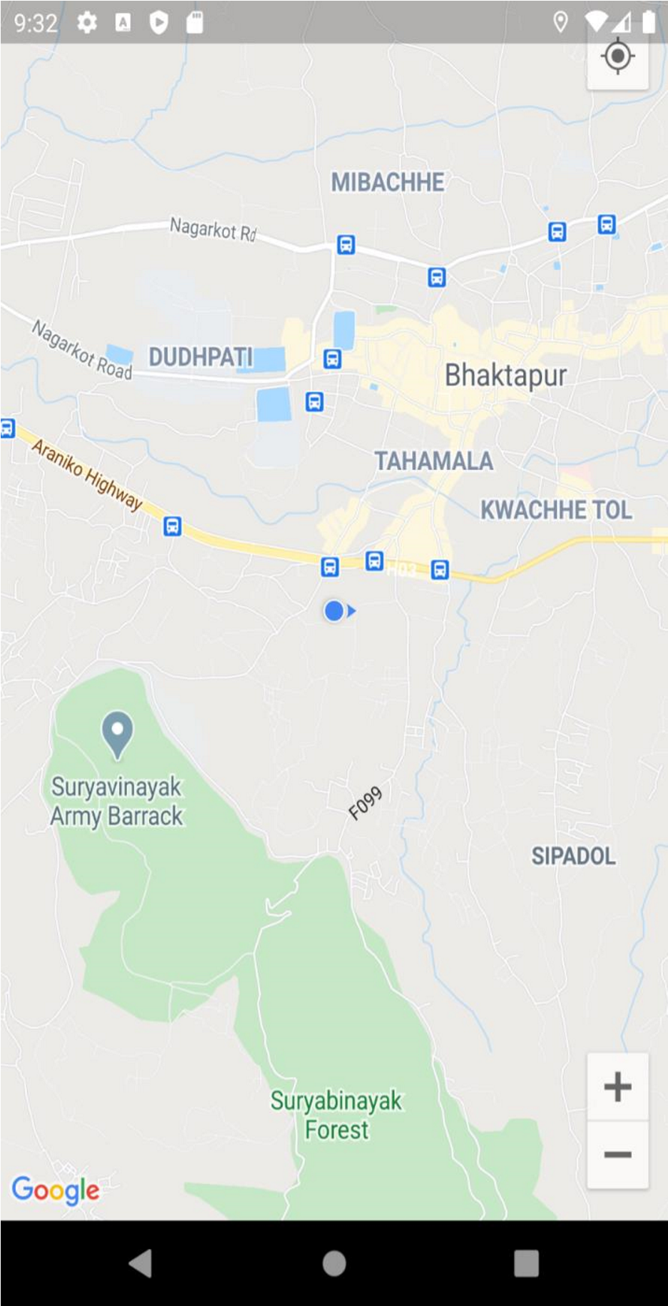
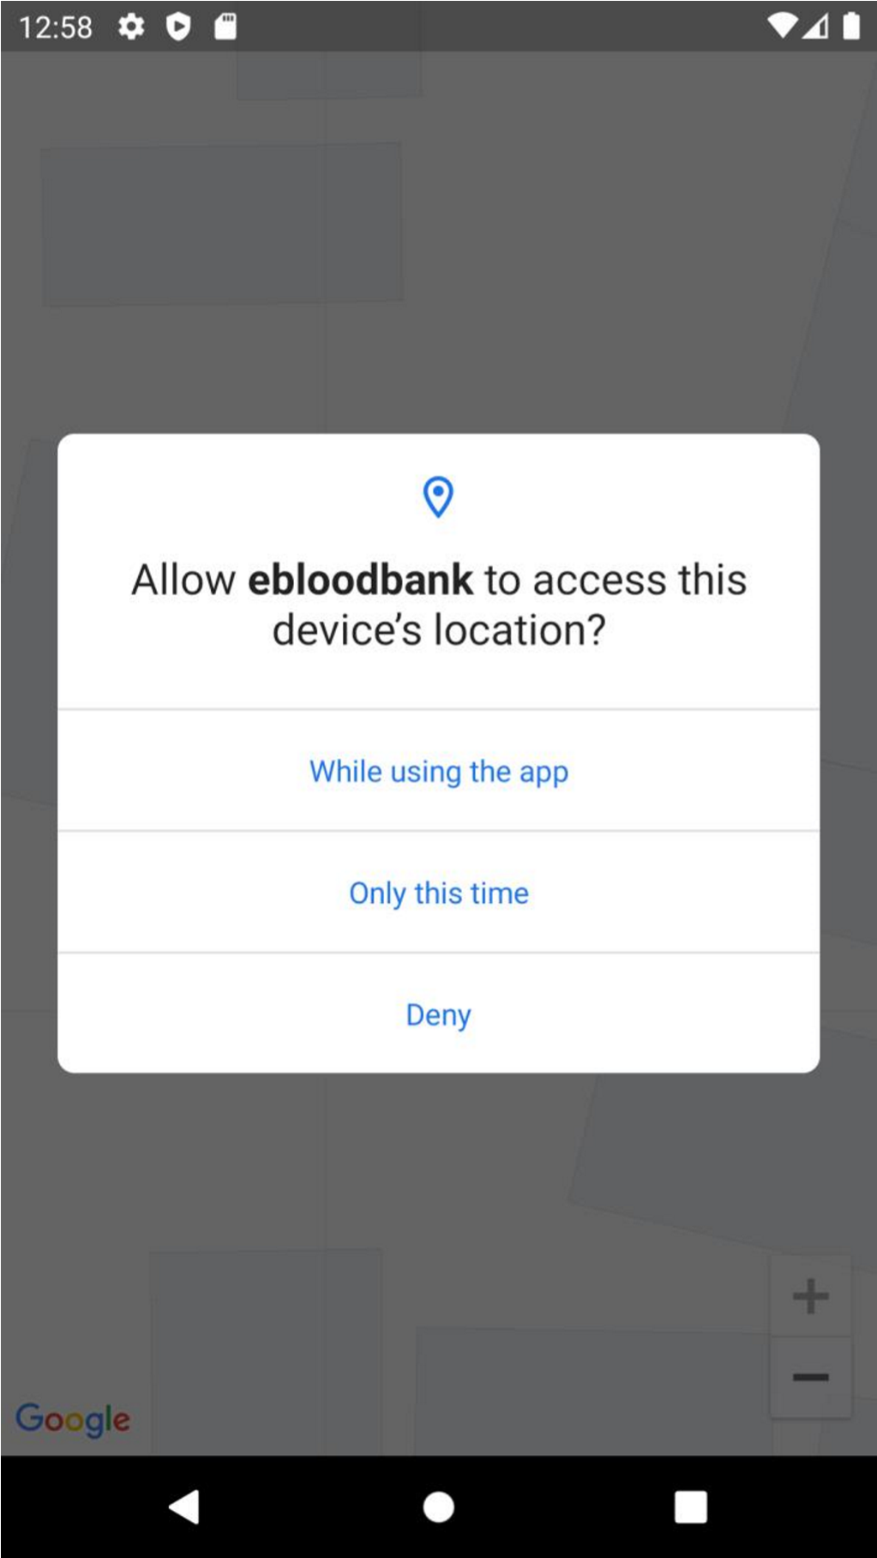
Fig 4:Google Map Navigation

Slide 19
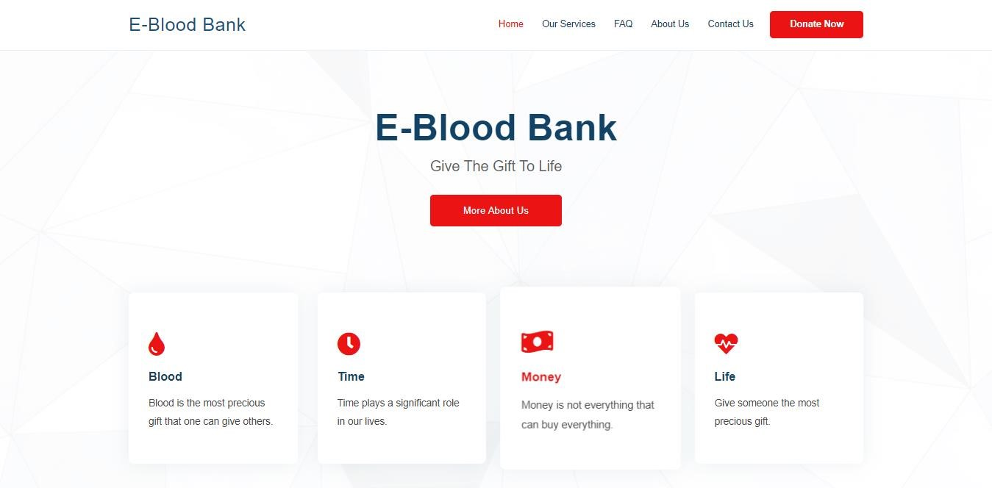
Web Dashboard

Slide 20
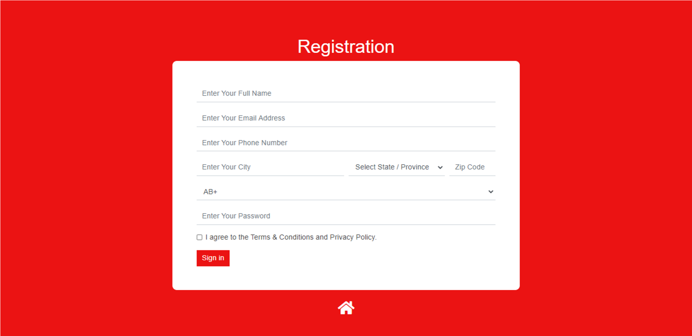
User Registration in Webpage

Slide 21
WORK TO BE DONE
Implementation of shortest path algorithm
Enhancement of User Interface between Mobile Application and Web Application

Slide 22
THANK YOU!!!

